Slide 1
Session 3: Statistical Prerequisites to Machine Learning
Muriah Wheelock
Zack Markow
Notes:
This presentation and the listed hypothesis tests are not meant to be encyclopedic

Slide 2
Outline
Correlation
covariance
correlation and dot products
multivariate outliers and collinearity
Regression
Simple, Multiple, and Logistic
Nuisance variables, shared variance, and residuals
Interactions and nonlinear terms
ANOVA/ANCOVA
General Linear Model

Slide 3
Correlation

Slide 4
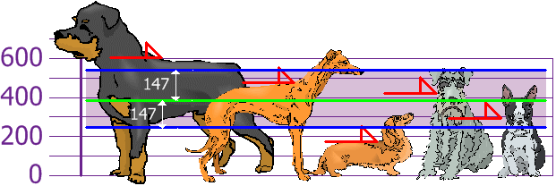
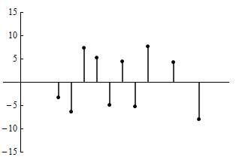
[Univariate] Error Variance
Session 1 and 2
standard deviation (SD)
standard error of the mean (SE)
Variance = SD²

Slide 5
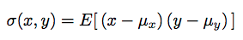
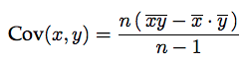
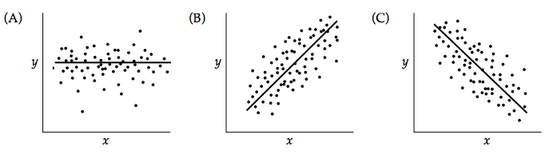
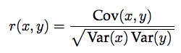
Covariance
Commonly: auto-covariance, dispersion matrix, variance matrix, and variance-covariance matrix
For vectors X and Y this can be calculated as
Mean of the pairwise cross-product x y minus the cross-product of the mean
Covariance is represented in the original units of the variables X and Y
Can also be written as
Relationship between correlation, variance, and covariance
Covariance = 0
Positive covariance
Negative covariance

Slide 6
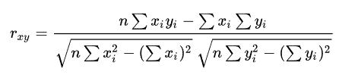
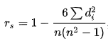
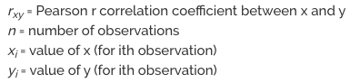
Correlation
The extent to which two variables are related to each other
Simple relationships that make no statement about cause or effect
Values are scale-independent (always range from -1 to 1)
How is it measured
Pearson r (linear assumes normality - the most widely used)
Spearman rho (rank-based non-parametric)
Kendall tau (rank-based non-parametric)
Relationship between correlation, variance, and covariance
Spearman 𝛒
Pearson r Long form

Slide 7
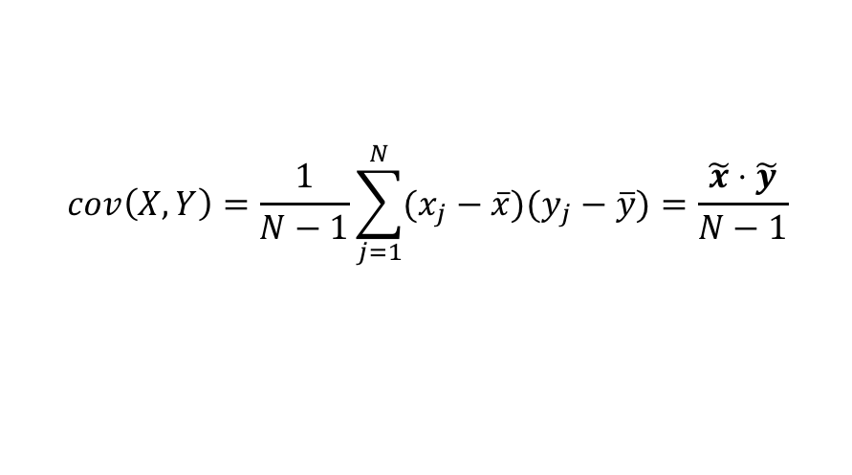
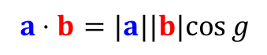
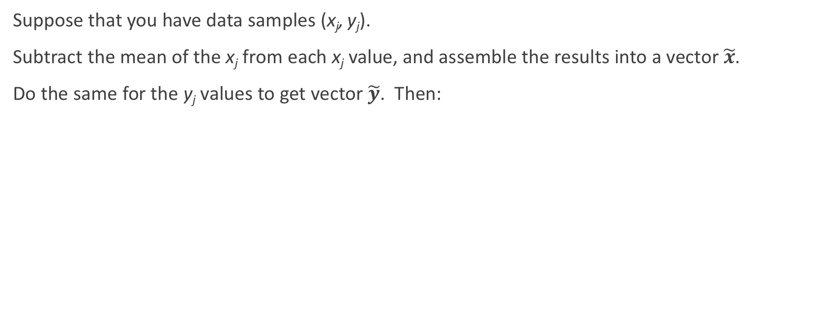
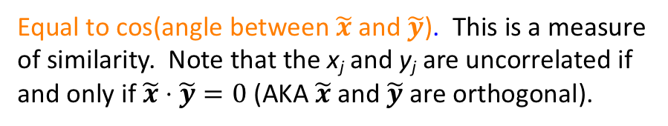


Pearson Correlation As Similarity and Normalized Vector Dot Product
Suppose that you have data samples (x_{j}, y_{j}).
Subtract the mean of the x_{j} from each x_{j} value, and assemble the results into a vector $\tilde{x}$.
Do the same for the y_{j} values to get vector $\tilde{y}$. Then:
a
$$cov\left(X,Y\right)=\frac{1}{N−1}\sum_{j=1}^{N}{(x_{j}−\overline{x})(y_{j}−\overline{y})}=\frac{\tilde{x}⋅\tilde{y}}{N−1}$$
$$a⋅b=|a||b|cos⁡g$$
Angle g
$$var\left(X\right)=cov\left(X,X\right)=\frac{\tilde{x}⋅\tilde{x}}{N−1}=\frac{{\left|\tilde{x}\right|}^{2}}{N−1}$$
b
True in any number N of dimensions.
$$corr\left(X,Y\right)=\frac{cov(X,Y)}{\sqrt{var\left(X\right)var(Y)}} =\frac{\tilde{x}⋅\tilde{y}}{\left|\tilde{x}\right||\tilde{y}|}$$
Equal to cos(angle between $\tilde{x}$ and $\tilde{y}$). This is a measure of similarity. Note that the x_{j} and y_{j} are uncorrelated if and only if $\tilde{x}⋅\tilde{y}=0$ (AKA $\tilde{x}$ and $\tilde{y}$ are orthogonal).

Slide 8
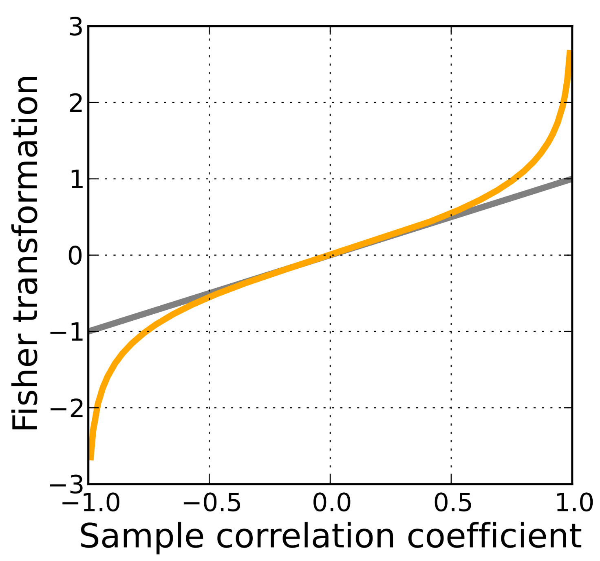
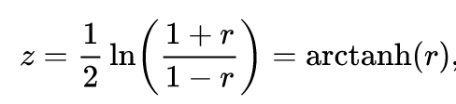
Hypothesis Tests on Pearson Correlation Coefficient
Pearson correlation coefficient between X and Y can be transformed to follow a Gaussian distribution if X and Y come from a bivariate Gaussian distribution.
Fisher’s r to z transformation:
Helpful for getting closer-to-Gaussian correlation distributions for testing (for example) differences between correlation values, even when X and Y are not bivariate Gaussian.
https://en.wikipedia.org/wiki/Fisher_transformation

Slide 9
Correlation vs Variance-Covariance Matrix
Critical for assessing Multivariate outliers
(also PCA, Factor analysis, canonical correlation, multivariate analysis of variance (MANOVA), etc.)

Slide 10
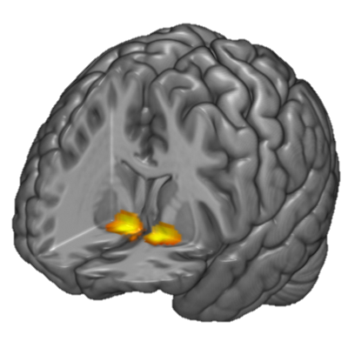
Correlation Significance
Correlation scales with sample size (large n = small p value)
Cohen’s standard (scale) can be used to evaluate strength
.1 small
.3 medium
>.5 large
.9 = ‘collinear’ (~R²>.8)
Variance explained
r squared (R²)
r =-.39
R² = .1521
‘Anxiety self-report explains 15% of the variance in amygdala activity’
Most brain-behavior correlations are medium to small

Slide 11
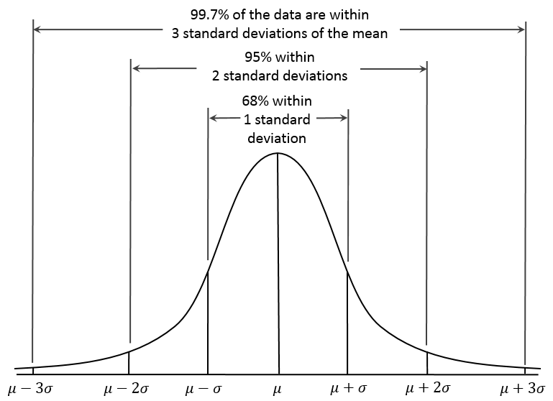
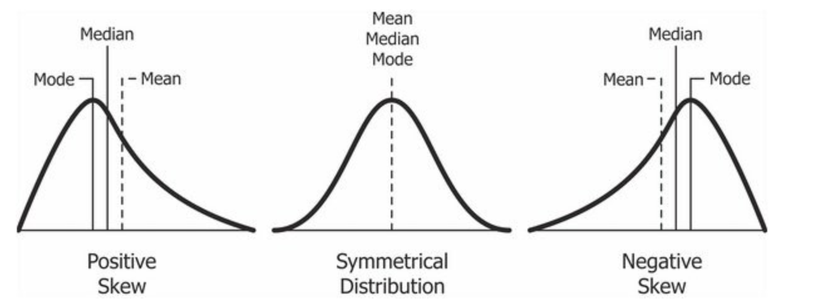
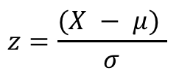
[Univariate] Outliers and skew
Session 2
Outliers reduce accurate estimates of mean and variance and reduce statistical power
Outliers can be handled with: Transformation/Winsorizing, Truncation/Exclusion/Censoring
$$z=\frac{(X − μ) }{σ}$$
3 sigma rule (in normally distributed data)
Tells how many SDs each data value is from the mean.

Slide 12
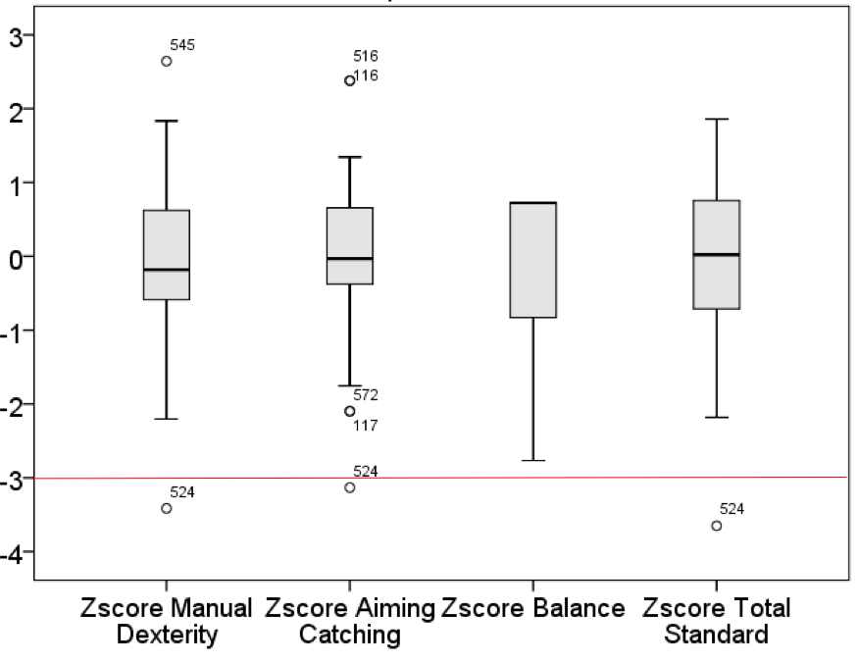
[Univariate] Outlier Detection via z-Scoring
Session 2
In large samples, a small number of outliers are expected
1 in 370 will be an outlier
5 in 1000
Outliers are cause for further investigation
Accidentally measuring a different patient population/distribution?
Instrument error?
Human error/Data entered incorrectly?
Fraudulent participant behavior?
3 Motor Tasks in healthy children (N=64)
Wheelock et al. (2018) NeuroImage
Why is subject 524 bad at manual dexterity and aiming/catching but fine at balance?

Slide 13
Bivariate and Multivariate Outliers
Outliers resulting from the combination of two or more variables
Outliers can impact the estimated relationship between two variables
Influence of outliers on the fit line is ‘Leverage’
Outliers that don’t exert leverage can be retained
Look at the change in fit line
(so much leverage)
Leverage can be calculated with
Cook’s Distance (D)
Censoring Bivariate Outliers impacts the estimated correlation

Slide 14
Bivariate and Multivariate Outliers
Outliers resulting from the combination of two or more variables
Outliers can impact the estimated relationship between two variables
Influence of outliers on the fit line is ‘Leverage’
Outliers that don’t exert leverage can be retained
Assess multivariate outliers with
Mahalanobis Distance

Slide 15
Regression

Slide 16
Regression Vocabulary
Regression
Generic term for statistical methods that attempt to fit a model to data
Dependent Variable (DV, commonly Y)
Outcome being predicted
Independent Variable (IV, commonly X)
Predictor variables
Covariates (also an IV, more X)
Nuisance variables which contribute to the prediction but aren’t of interest
Unknown parameter estimates (𝛽)
The degree to which an IV (X) explains variance in DV (Y)

Slide 17
Common types of Regression
Simple Linear Regression = 1 IV and 1 DV
Multiple Linear Regression = Many IVs and 1 DV
Logistic Regression = Many IVs and 1 discrete DV (e.g. doctorate vs no doctorate)
Dependent Variable has a continuous distribution
e.g. cumulative years of education
(IVs can be discrete or continuous)
These concepts are fundamental to many supervised machine learning models
Support Vector Machine/Support Vector Regression
Decision Tree Regression/Random Forest Regression
Multinomial Logistic Regression/softmax regression/maximum entropy
Lasso Regression/Ridge Regression/ElasticNet regression

Slide 18
Getting ready to do regression
Check for and address outliers
Missing data
Exclude all pairwise missing cases
Interpolate missing data (e.g. the group mean)
Transform variables
Mean center your IVs (crucial if you want to interpret the intercept)
Z-scoring data
Standardized vs Unstandardized beta values
Most regression defaults to unstandardized beta (SPSS will compute both)
Neuroimaging software do not z-score
Don’t Z-score if you want to use the beta to predict future behavior
sex | wrong | correct | wrong | correct
female | 1 | -1 | 24 | -6.43
male | 2 | 1 | 22 | -8.43
male | 2 | 1 | 20 | -10.43
female | 1 | -1 | 38 | 7.57
female | 1 | -1 | 49 | 18.57
female | 1 | -1 | 19 | -11.43
male | 2 | 1 | 41 | 10.57

Slide 19
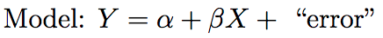
Simple Linear Regression
Simple Linear Regression
Fit a straight line between an outcome (Y) and predictor variable (X)
Assumes
X and Y have a linear relationship and Y is continuous
No significant outliers
Residuals are independent (uncorrelated with each other)
Variance of the residuals is constant (homoscedasticity)
PFC
DV
IV
PFC functional connectivity
intercept
slope
residuals
Trait anxiety

Slide 20
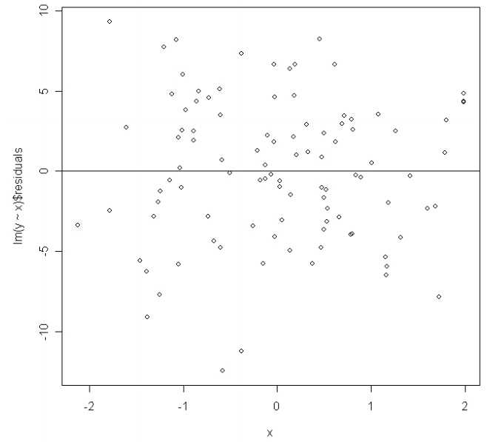
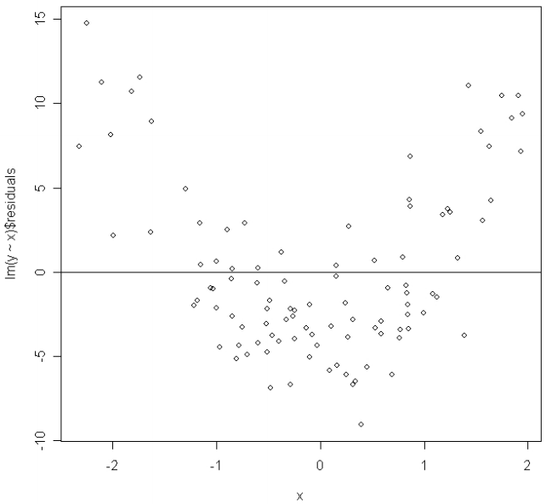
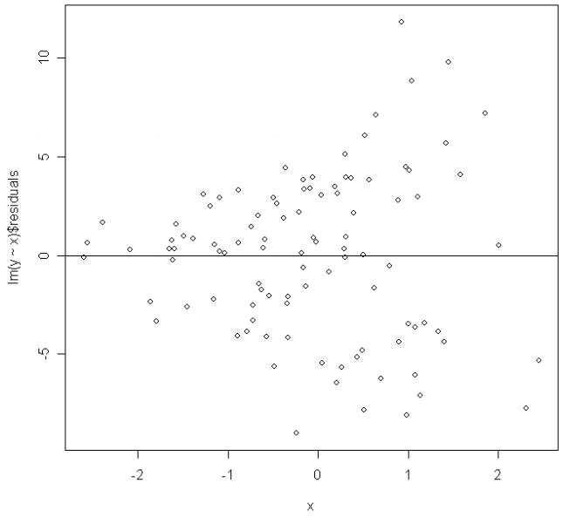
Simple Linear Regression
Simple Linear Regression
Fit a straight line between an outcome (Y) and predictor variable (X)
Residuals are independent (centered around 0)
(Homoscedasticity)
Residuals increase as X increases
(Variance is not constant)
(Heteroscedasticity)
Residuals are U shaped
X and Y are not linear
residuals
residuals
residuals
x
x
x

Slide 21
Simple Linear Regression
Shared variance
DV
(Anxiety)
PFC
IV
(PFC)
Trait anxiety
PFC activity
Output are similar to correlation
r and R² are estimated for the model
lets say for this example PFC explains 20% of variance in trait anxiety
Different in that model significance is determined with the F statistic
Large F statistic means your predictors were better than the intercept
You also get an intercept, Unstandardized Beta (𝛽 ) coefficient, t statistic, and p value for the predictor variable
Lets say Intercept = 0.13, 𝛽=.564 , t=7.598, p<0.001
Can be interpreted as trait anxiety = 0.13+0.564(PFC activity)
Given this model, can input someone’s PFC activity and predict what that person’s trait anxiety would be (biomarkers) – however 80% of variance isn’t accounted for
PFC functional connectivity
Trait anxiety

Slide 22
Multiple regression
More than one (IV) predictor variable makes this now ‘multiple regression’
How you choose to partial variance matters
DV
IV₁
IV₂

Slide 23
Multiple regression/ANOVA
More than one (IV) predictor variable makes this now ‘multiple regression’
How you choose to partial variance matters
Partial regression is the default in many software suites
Statements about predictors are completely independent of other IVs
Conceptually similar to Analysis of Variance (ANOVA)
ANOVA of categorical variables tests difference in means
An extension of t-test for more than one group
ANOVA of continuous variables uses the same stats as regression
They evolved separately but solve the same type of problems
Unique variance due to IV₁ while removing effects of IV₂
Variance removed from the model
DV
DV
IV₁
IV₁
IV₂
IV₂
partial correlation
Semi-partial correlation

Slide 24
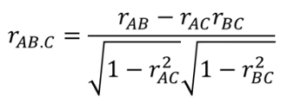
Multiple Regression with covariates
Covariates are nuisance variables of no interest (e.g. sex, age, head motion)
Include nuisance variables in the model to improve your model fit
Minimize the sum of squared residuals
Explain maximum variance in the dependent variable
Partial out (i.e. regress out) variance in DV due to Covariates
using the correlations of their residuals
Variance removed from the model
Shared variance between DV and IV is of interest
DV(B)
DV(B)
IV(A)
IV(A)
Covariate(C)
Covariate(C)
partial regression
Semi-partial regression
Regress out covariate from IV and DV
Regress out of DV (or IV) only

Slide 25
Multiple Regression with covariates
Covariates are nuisance variables of no interest (e.g. sex, age, head motion)
Include nuisance variables in the model to improve your model fit
Minimize the sum of squared residuals
Explain maximum variance in the dependent variable
Partial out (i.e. regress out) variance in DV due to Covariates
using the correlations of their residuals
This is conceptually similar to ANCOVA
Analysis of Covariance will partial variance for you
Shared variance between DV and IV is of interest
DV(B)
DV(B)
IV(A)
IV(A)
Don’t partial out variance due to covariates if the variable you are regressing out is highly correlated with your DV or your IV (you will be removing variance of interest from your model)
Covariate(C)
Covariate(C)
partial regression
Semi-partial regression
Regress out covariate from IV and DV
Regress out of DV only

Slide 26
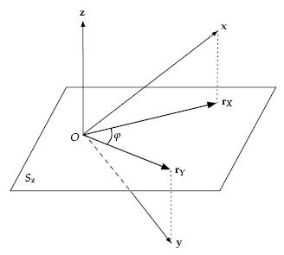
Geometric Interpretation of Partial Correlation and “Regressing Out” Covariates
“Regress z out of x and y” means: fit linear regression models x = b₁z + b₀ + error and y = c₁z + c₀ + error, then replace x and y with the fit residuals r_{x} and r_{y}.
Residuals are orthogonal to z-E(z) (uncorrelated with z) after regressing z out from x and y (AKA “partialing variance from z out” of x and y).
“Partial correlation between x and y controlling for covariate z” = correlation between residuals r_{x} and r_{y}.
>> Example: Global signal regression before functional connectivity analysis.
N-dimensional space, N = Number of observations (number of values in x).
CC BY-SA 3.0, https://en.wikipedia.org/w/index.php?curid=8820583
For partial correlation controlling for multiple covariates (e.g., z and w), regress them all out of x and y to form residuals.

Slide 27
Multiple regression with Interaction terms
An interaction between two variables is the basis for Moderation
Expanded regression equation with Y= X₁ + X₂ + X₁X₂
Test whether DV is due to the interaction between variables
Do you specify all possible interactions?
Full factorial
Only the interactions hypothesized/of interest?
Difference in slopes between two groups (ORL predoctoral vs PIs) in correlation between loss of sleep (DV) and anxiety (continuous IV)
Loss of sleep = group + anxiety + groupXanxiety
(Two groups)
(DV)
(one categorical IV with two levels)

Slide 28
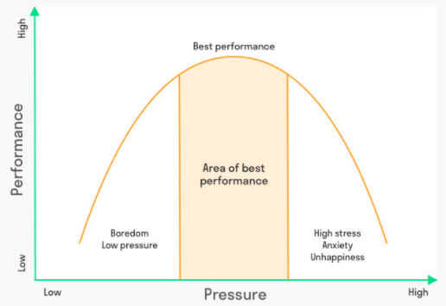
Polynomial Regression
Polynomial regression is just a special case of multiple regression
Useful for situations in which the relationship is thought to be nonlinear
Just square those terms!
Make sure to still include the first order terms in the model
Y= X₁ + X₂ + X₁² + X₂² + X₁X₂²

Slide 29
Logistic Regression
Multiple regression with a dichotomous outcome (categorical DV)
Useful for predicting clinical outcome (treatment response Y/N)
Features predictive of disease onset (early detection of Autism diagnosis)
Conceptually similar to Classification in machine learning
Support Vector Machine (SVM)

Slide 30
Important Assumptions Recap
Outliers – assess with z-score/Mahalanobis distance
Multicollinearity
Covariate that is collinear with DV = very bad (removing variance from the model)
Two or more collinear IVs will falsely inflate the beta and variance explained
When variables are colinear
Exclude redundant variables
Ignore if you only care about predicting y and don’t care about interpreting specific contribution from individual betas
Don’t use least squares (e.g. use ridge regression)
Missing data
Exclude or interpolate
Sample size/cell size
It’s not just about your total sample size, but how many subjects you have in each condition/timepoint
Need to watch your minimum cell size and large differences in cell sizes between conditions

Slide 31
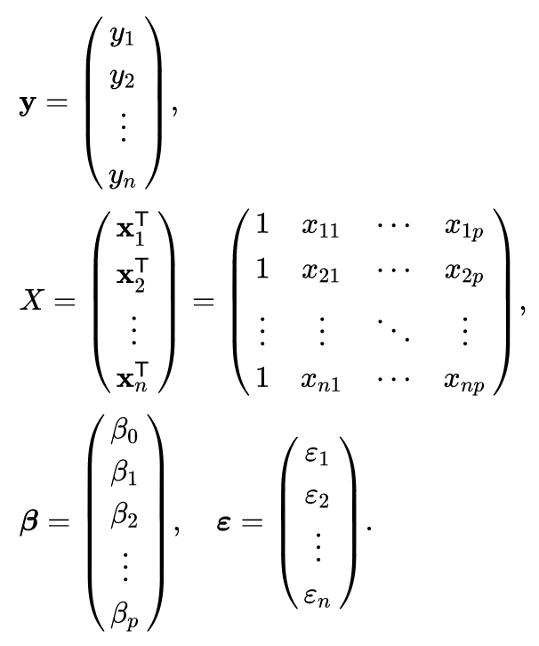

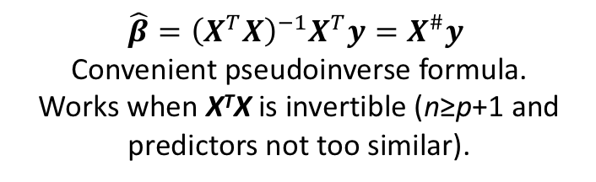
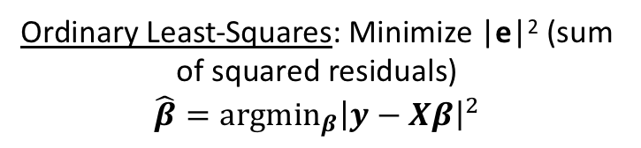
Fitting the Model Weights in Linear Regression: Ordinary Least-Squares
Model: $y=β_{0}+β_{1}X_{1}+β_{2}X_{2}+…+β_{p}X_{p}+e$
n Data Points: (x_{j,1}, x_{j,2}, …, y_{j})
p Predictor/Independent Variables
Can write this equation once for each data point.
Gives system of n equations in p+1 unknowns.
Matrix form: $y=Xβ+e$
Choose weights that minimize mismatch between model and data.
Ordinary Least-Squares: Minimize |e|² (sum of squared residuals)
$$\hat{β}={argmin}_{β}{{\left|y−Xβ\right|}^{2}}$$
=
+
$$\hat{β}={\left(X^{T}X\right)}^{−1}X^{T}y=X^{\#}y$$
Convenient pseudoinverse formula.
Works when X^{T}X is invertible (n≥p+1 and predictors not too similar).
n rows x p+1 columns
https://en.wikipedia.org/wiki/Linear_regression

Slide 32

Fitting the Model Weights in Linear Regression: Ordinary Least-Squares
Model: $y=β_{0}+β_{1}X_{1}+β_{2}X_{2}+…+β_{p}X_{p}+e$
n Data Points: (x_{j,1}, x_{j,2}, …, y_{j})
p Predictor/Independent Variables
Can write this equation once for each data point.
Gives system of n equations in p+1 unknowns.
Matrix form: $y=Xβ+e$
Choose weights that minimize mismatch between model and data.
Ordinary Least-Squares: Minimize |e|² (sum of squared residuals)
$$\hat{β}={argmin}_{β}{{\left|y−Xβ\right|}^{2}}$$
=
+
Equivalent to maximum likelihood estimation of weights when residuals are IID Gaussian.
n rows x p+1 columns
https://en.wikipedia.org/wiki/Linear_regression

Slide 33
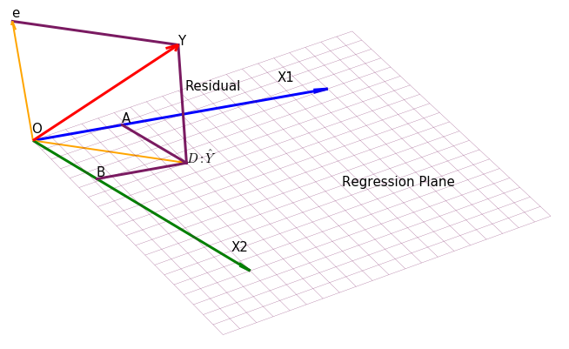
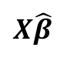
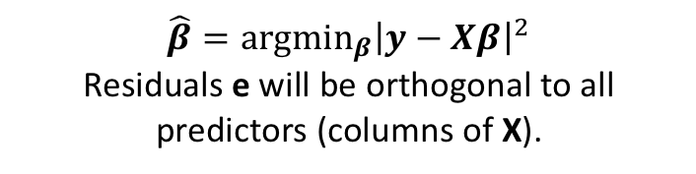
Fitting the Model Weights in Linear Regression: Ordinary Least-Squares
Model: $y=β_{0}+β_{1}X_{1}+β_{2}X_{2}+…+β_{p}X_{p}+e$
$$\hat{β}={argmin}_{β}{{\left|y−Xβ\right|}^{2}}$$
Residuals e will be orthogonal to all predictors (columns of X).
Can write this equation once for each data point.
Gives system of n equations in p+1 unknowns.
Matrix form: $y=Xβ+e$
$$X\hat{β}$$
=
+
n rows x p+1 columns
https://st3.ning.com/topology/rest/1.0/file/get/2808326570?profile=original
https://en.wikipedia.org/wiki/Linear_regression

Slide 34
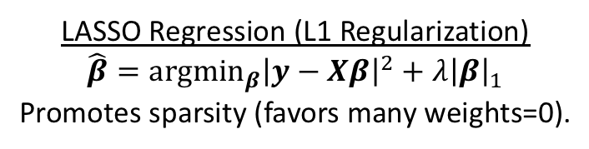

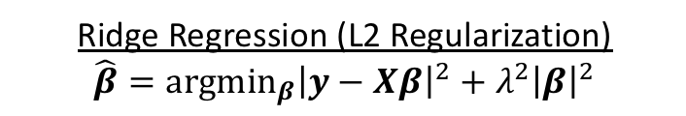
Fitting the Model Weights in Linear Regression: Variations
Model: $y=β_{0}+β_{1}X_{1}+β_{2}X_{2}+…+β_{p}X_{p}+e$
n Data Points: (x_{j,1}, x_{j,2}, …, y_{j})
p Predictor/Independent Variables
Can write this equation once for each data point.
Gives system of n equations in p+1 unknowns.
Matrix form: $y=Xβ+e$
When you have highly correlated predictors, n<p+1, and/or quite noisy data, can use regularization to avoid overfitting and unstable weights.
Ridge Regression (L2 Regularization)
$$\hat{β}={argmin}_{β}{{\left|y−Xβ\right|}^{2}+λ^{2}{\left|β\right|}^{2}}$$
=
+
$$\hat{β}={\left(X^{T}X+λ^{2}I\right)}^{−1}X^{T}y$$
LASSO Regression (L1 Regularization)
$$\hat{β}={argmin}_{β}{{\left|y−Xβ\right|}^{2}+λ{\left|β\right|}_{1}}$$
Promotes sparsity (favors many weights=0).
n rows x p+1 columns
https://en.wikipedia.org/wiki/Linear_regression

Slide 35


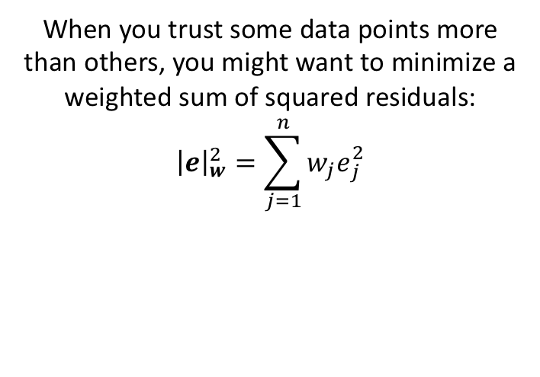
Fitting the Model Weights in Linear Regression: Variations
Model: $y=β_{0}+β_{1}X_{1}+β_{2}X_{2}+…+β_{p}X_{p}+e$
n Data Points: (x_{j,1}, x_{j,2}, …, y_{j})
p Predictor/Independent Variables
Can write this equation once for each data point.
Gives system of n equations in p+1 unknowns.
Matrix form: $y=Xβ+e$
When you trust some data points more than others, you might want to minimize a weighted sum of squared residuals:
$${\left|e\right|}_{w}^{2}=\sum_{j=1}^{n}{{w_{j}e}_{j}^{2}}$$
=
+
Weighted Least Squares
$$\hat{β}={argmin}_{β}{{\left|y−Xβ\right|}_{w}^{2}}$$
$$\hat{β}={\left(X^{T}WX\right)}^{−1}X^{T}y$$
n rows x p+1 columns
Maximum likelihood estimate if residuals are Gaussian but have different variance 1/w_{j} for different data points (heteroscedastic).
https://en.wikipedia.org/wiki/Linear_regression

Slide 36
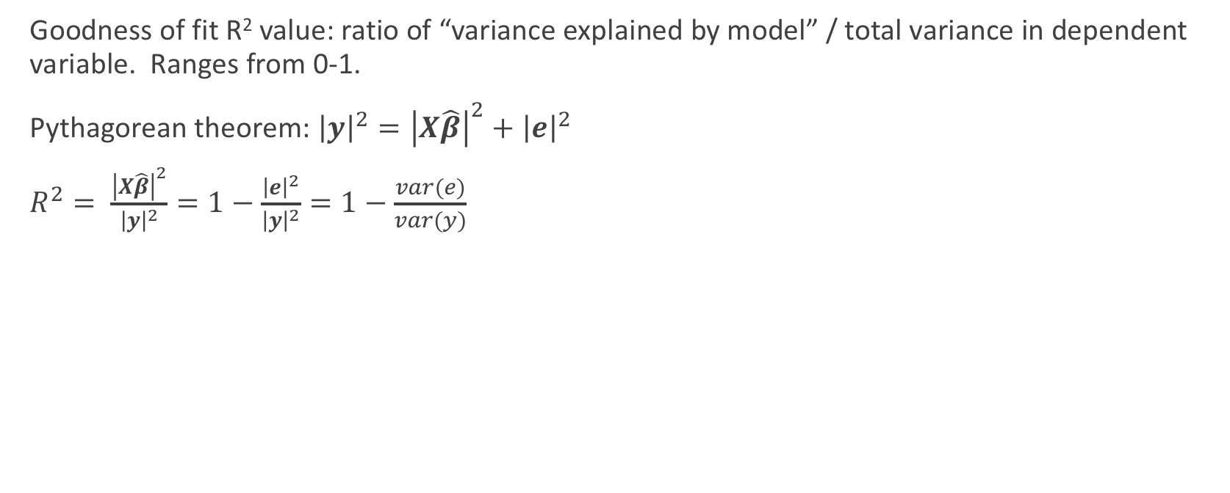
Evaluating Regression Performance
Goodness of fit R² value: ratio of “variance explained by model” / total variance in dependent variable. Ranges from 0-1.
Pythagorean theorem: ${\left|y\right|}^{2}={\left|X\hat{β}\right|}^{2}+{\left|e\right|}^{2}$
$R^{2}= \frac{{\left|X\hat{β}\right|}^{2}}{{\left|y\right|}^{2}}=1−\frac{{\left|e\right|}^{2}}{{\left|y\right|}^{2}}=1−\frac{var(e)}{var(y)}$
Matrix form: $y=Xβ+e$
$$X\hat{β}$$
https://st3.ning.com/topology/rest/1.0/file/get/2808326570?profile=original

Slide 37
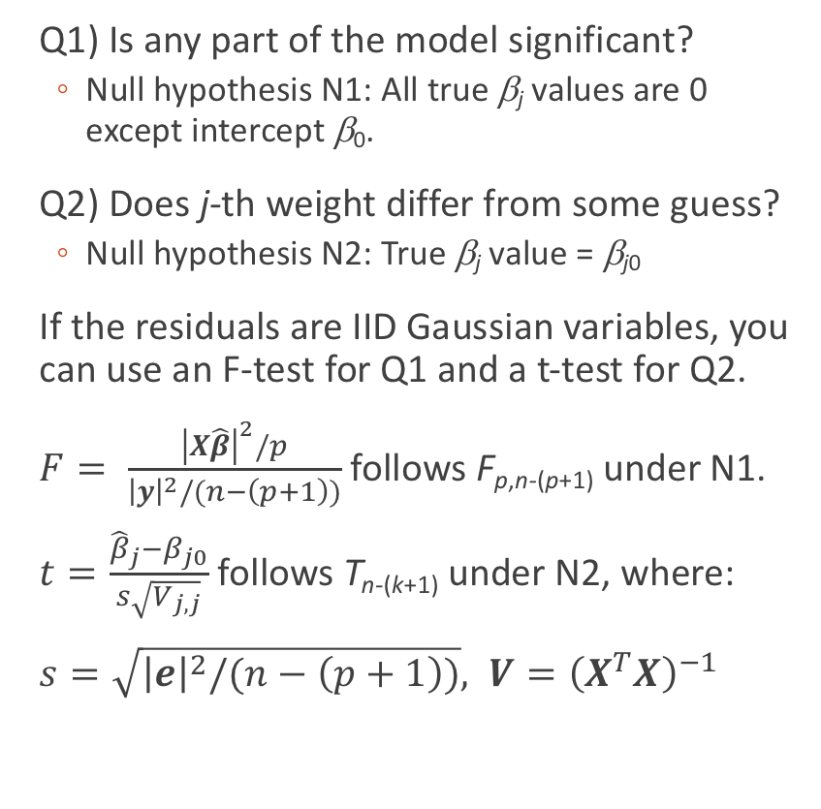
Evaluating Regression Performance: Statistical Significance of Fit
Q1) Is any part of the model significant?
Null hypothesis N1: All true β_{j} values are 0 except intercept β₀.
Q2) Does j-th weight differ from some guess?
Null hypothesis N2: True β_{j} value = β_{j0}
If the residuals are IID Gaussian variables, you can use an F-test for Q1 and a t-test for Q2.
$F= \frac{{\left|X\hat{β}\right|}^{2}/p}{{\left|y\right|}^{2}/(n−\left(p+1\right))}$ follows F_{p,n-(p+1)} under N1.
$t=\frac{{\hat{β}}_{j}−β_{j0}}{s\sqrt{V_{j,j}}}$ follows T_{n-(k+1)} under N2, where:
$s=\sqrt{{\left|e\right|}^{2}/(n−\left(p+1\right))}, V={\left(X^{T}X\right)}^{−1}$
Matrix form: $y=Xβ+e$
$$X\hat{β}$$
https://st3.ning.com/topology/rest/1.0/file/get/2808326570?profile=original
Tamhane and Dunlop 2000

Slide 38
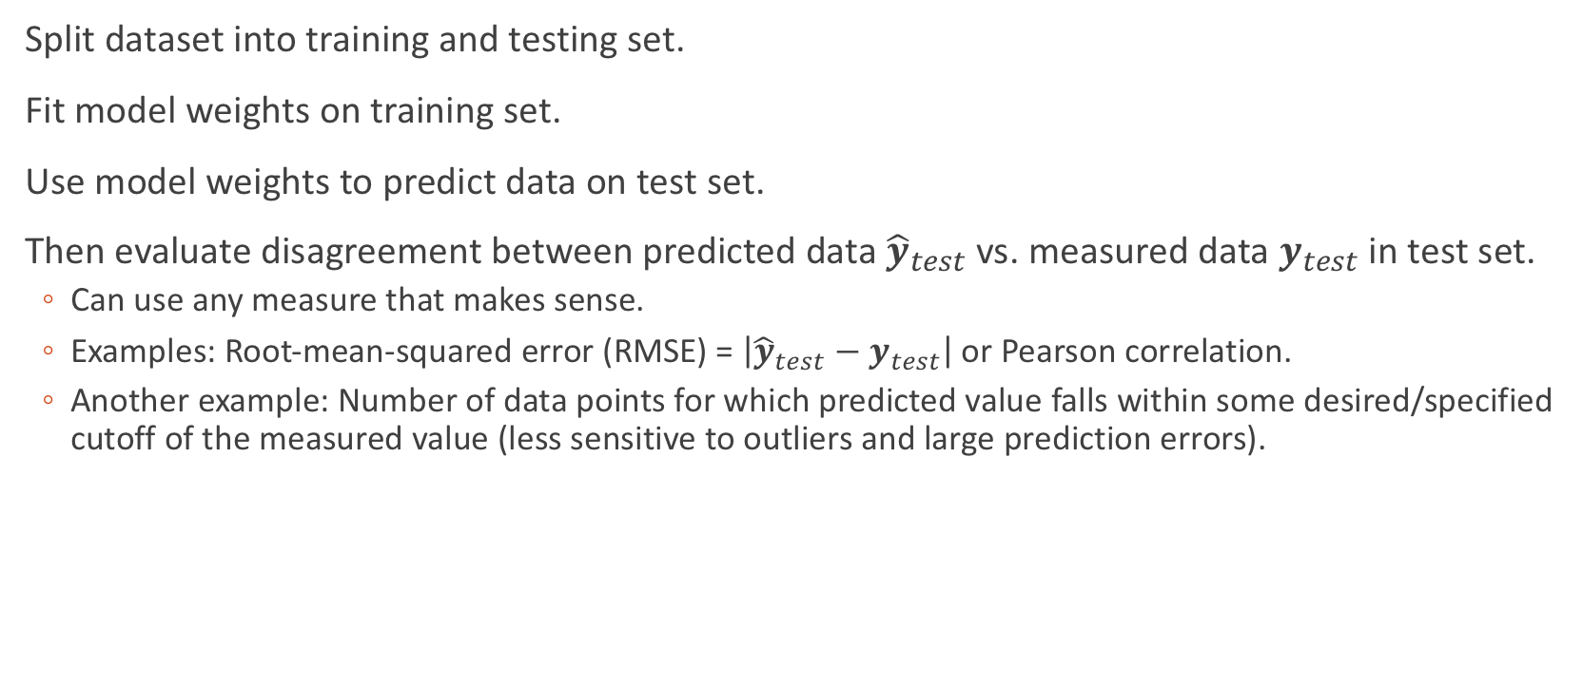
Evaluating Regression Performance: Prediction Accuracy
Split dataset into training and testing set.
Fit model weights on training set.
Use model weights to predict data on test set.
Then evaluate disagreement between predicted data ${\hat{y}}_{test}$ vs. measured data $y_{test}$ in test set.
Can use any measure that makes sense.
Examples: Root-mean-squared error (RMSE) = $\left|{\hat{y}}_{test}−y_{test}\right|$ or Pearson correlation.
Another example: Number of data points for which predicted value falls within some desired/specified cutoff of the measured value (less sensitive to outliers and large prediction errors).

Slide 39
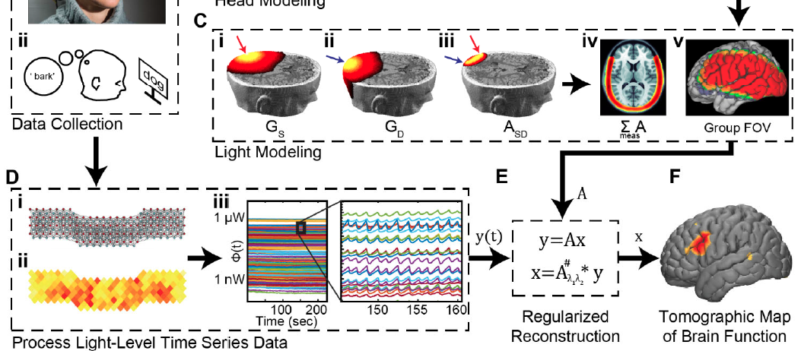
General Linear Model
Closing remarks…
Comparing Groups or Behavior
GLM
The most general regression equation
It allows for Y to be transformed
The models we covered today are all special cases of the GLM
Simple regression
ANOVA
ANCOVA
Multiple regression
RMANCOVA
Logistic Regression
Mixed Models
Poisson Regression
Full factorial
Polynomial
RMANOVA
Modeling Brain Activity
DOT Image Reconstruction
The GLM is fundamental to neuroimaging research

Slide 40
References
Tamhane AC, Dunlop DD. Statistics and Data Analysis: from Elementary to Intermediate. Upper Saddle River, NJ: Prentice-Hall, 2000.

